Slide 1



Lending Club Case Study
Group Members :
Sumaiya K
Shubham Mishra

Slide 2
Problem Statement
Considering we work for Consumer finance company which lends various types of loans to urban customer. When a person applies for a loan, there are two types of decisions that could be taken by the company:
Loan accepted
Loan rejected

Slide 3
Business Objective
The aim of this case study is to identify the Risky Loan Applicants indicated as default to reduce the Credit loss by deriving strong indicators by using the company’s available data to asses the further loan applications for its Portfolio and Risk Assessment.
Identify the applicants who tend to fall under Default category
Understanding of Driving factors for defaulted loan process
Company to Utilize the indicators/knowledge for Risk Assessment for new Applications

Slide 4
Data Analysis
Data Understanding
Analysed data dictionary and its columns.
Analysed columns with their specific uses in the domain
Data Cleaning
Extracted all the null values with percentage and unnecessary variables
Removed null values and made it to 0%
Univariate/Segmented Analysis
Plotted various graphs by analysis of columns and driver variables
Bivariate/Multivariate Analysis
Performed bivariate and multivariate analysis to understand how different variable can interact with each other.
Recommendations for reducing the loss of business by analysing and detecting variables which contributes to loan defaulters.
Recommendations

Slide 5
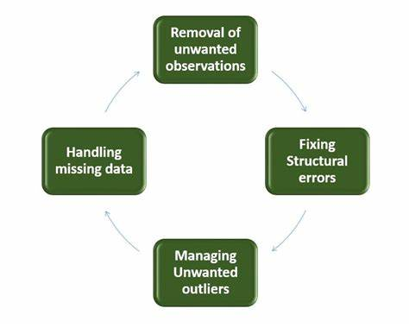
Data Cleaning Techniques
In Python, missing data is represented using either of the two objects NaN (Not a Number) or NULL. We'll not get into the differences between them and how Python stores them internally etc. We'll focus on studying ways to identify and treat missing values in Pandas dataframes.
STEPS :
• Delete columns: Delete unnecessary columns.
• Remove outliers: Remove high and low values that would disproportionately affect the results of your analysis.
• Missing values: Treat missing values with appropriate approach.
• Duplicate data: Remove identical rows, remove rows where some columns are identical.
• Filter rows: Filter by segment, filter by date period to get only the rows relevant to the analysis.

Slide 6

Data Cleaning Techniques
There are four main methods to identify and treat missing data:
isnull(): Indicates presence of missing values, returns a boolean
notnull(): Opposite of isnull(), returns a boolean
dropna(): Drops the missing values from a data frame and returns the rest
fillna(): Fills (or imputes) the missing values by a specified value
Treating Missing Values
Delete: Delete the missing values
Impute:
Imputing by a simple statistic: Replace the missing values by another value, commonly the mean, median, mode etc.
Predictive techniques: Use statistical models such as k-NN, SVM etc. to predict and impute missing values

Slide 7
Univariate/Segmented Analysis
Univariate is a term commonly used in statistics to describe a type of data which consists of observations on only a single characteristic or attribute
Categorical univariate data
Categorical univariate data consists of non-numerical observations that may be placed in categories.
Numerical univariate data
Numerical univariate data consists of observations that are numbers.

Slide 8
Univariate/Segmented Analysis

Slide 9
Univariate/Segmented Analysis

Slide 10
Univariate/Segmented Analysis

Slide 11
Bivariate/Multivariate Analysis

Slide 12
Bivariate/Multivariate Analysis

Slide 13
Bivariate/Multivariate Analysis

Slide 14
Bivariate/Multivariate Analysis

Slide 15
Recommendation

Slide 16
Conclusion

Slide 17
References
Financial Risk Analysis - 5+ Examples, Format, Pdf | Examples
Financial Risk Management Process - Overview and Steps (corporatefinanceinstitute.com)
https://www.bing.com/search?q=eda+univariate+analysis&cvid=efc56cbee14c408ca45870fac94f6979&aqs=edge.4.0j69i57j0l7.4809j0j4&FORM=ANAB01&PC=DCTS
Univariate Analysis | Exploratory Bivariate and Multivariate Analysis (analyticsvidhya.com)
Understanding ‘Segmented Univariate Analysis’ | by Analyttica Datalab | Medium
How to Calculate Correlation Between Variables in Python - MachineLearningMastery.com
Exploratory Data Analysis in Python — A Step-by-Step Process | by Andrea D'Agostino | Towards Data Science

Slide 18
Thank You

